Slide 1
Bray Team Week 12 Update
Avery Haynes, Locke Lehmann, Travis Carlson, Cody Sims, Zachary Walker, Michael Hager
11/06/2023

Slide 2
Problem Statement Summary
Develop a method to internally measure valve position independent of an actuator, measure actuator output torque, and detect fluid leakage to increase the valve's service life.
Priorities: position and torque
Bray cares about all three, customers care about torque and leakage
Existing solution: IOT Torque Bracket

Slide 3
Week 11 Deliverables
Week 11 Tasks
Deliverable | Team Member | Percent Completed | Notes
Finish and submit DR2 Report | All | 100%
Create preliminary budget request | Avery | 40% | Talk with Bray about what they want to provide
Consult ChatGPT for fun | Travis | 100% | It pretty much agrees with our ideas

Slide 4
Week 12 Plans
Week 12 Tasks
Deliverable | Team Member | Percent Completed | Notes
Finish preliminary budget and submit | Avery | 40%
Discuss cost items and next steps with Bray | All | 0% | Will discuss at Monday afternoon meeting
Create more detailed plan for design implementation | All | 15% | More details about fit, installation, potentially using Bray's spare valves

Slide 5
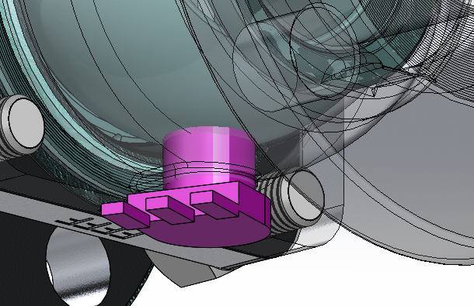
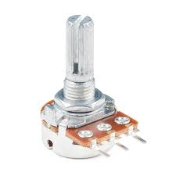
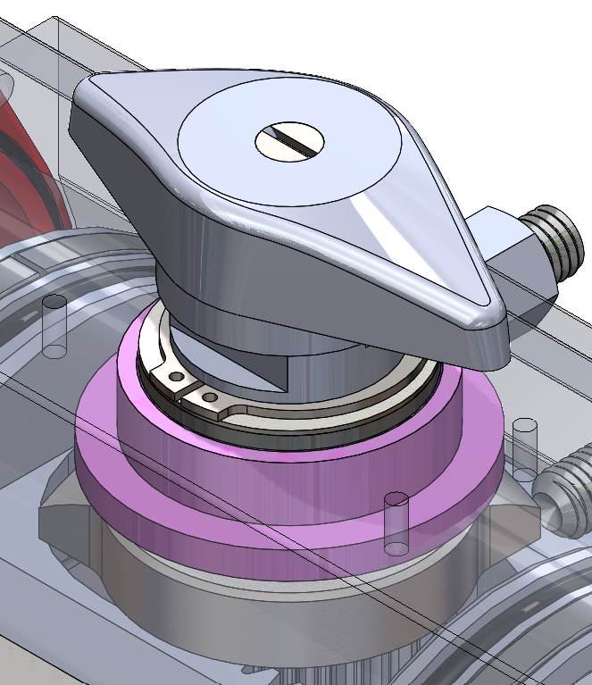
Embodiment Design

Slide 6
Embodiment Design
Potentiometers can be ordered online
Each will be roughly 1-2 cubic inches
Will be fastened around the torque shaft or to the bottom of the ball valve casing (with a hole drilled through the casing)
Will not interfere with valve operation as fluid does not flow in that region of the casing
Connected to wires, possibly an external DAQ or similar device to transmit data

Slide 7
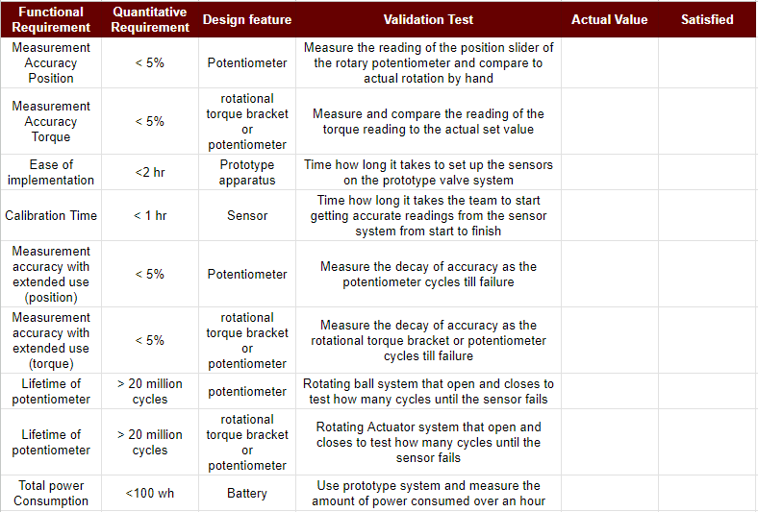
Validation Planning

Slide 8
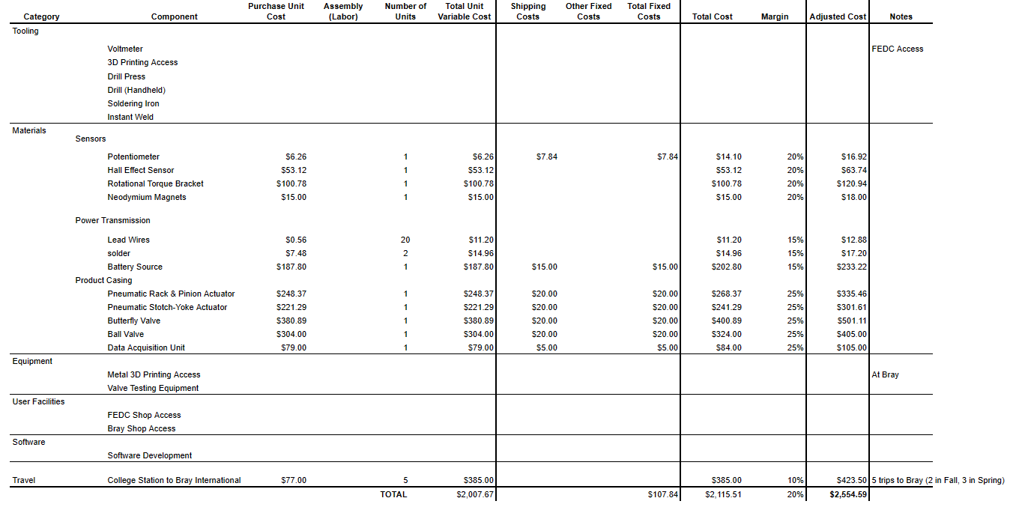
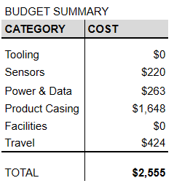
Budget Estimate

Slide 9
Sponsor Thoughts
Approved of final design concept (potentiometer)
Approved locations provided for the potentiometer, as well as gave insight on how to go about successfully implementing our design.

Slide 10
Subsystems
Through the rest of 401, our team plans on finishing our final design concept, price approximation, and setting arrangements for the prototyping phase.
For 402, our final design will be split up into 2 subsystems, one pertaining to measuring the true valve position while the other pertaining to the actuator output torque.

Slide 11
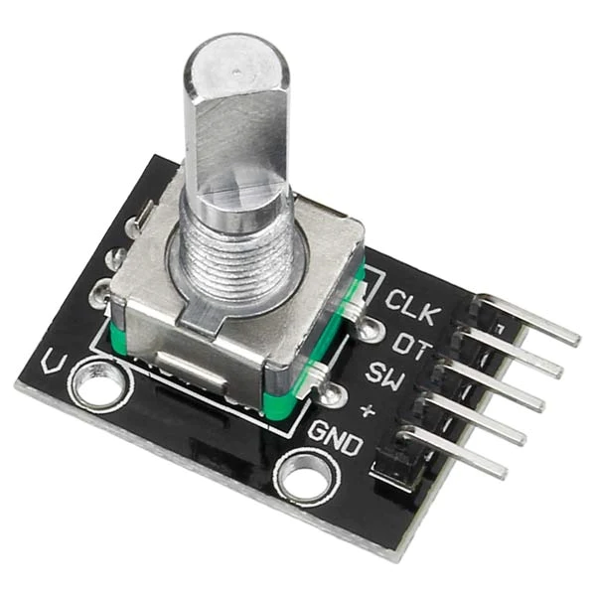
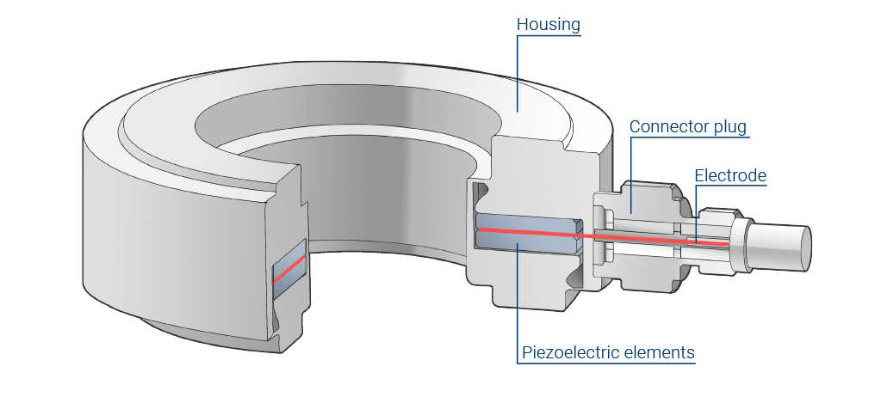
ChatGPT Agrees
Concepts:
Rotary Encoder for valve position
Strain gauge/Load cells for actuator torque
Piezoelectric load cell

Slide 12
References
https://www.hbkworld.com/en/knowledge/resource-center/articles/how-does-a-piezoelectric-force-transducer-work
https://www.addicore.com/products/rotary-encoder-with-push-switch

